Slide 1
FY 2026 NSGP Process Overview for State Administrative Agencies (SAAs)
Grant Programs Directorate
Federal Emergency Management Agency
Notes:
Title slide + Image Option 2

Slide 2







Table of Contents
1. Key Info for FY 2026 & Grants.gov File Names
2. Available Processes & Next Steps
3. Export Process Terminology
4. Suggested Export Process Map
5. Export Process Instructions
6. Migration Process Instructions
7. Export & Migration Process Recap

Slide 3
Key Info for FY 2026

Slide 4
Key Info for Fiscal Year (FY) 2026
All required files are available on Grants.gov. Make sure to download the FY 2026 versions!
The Investment Justification template required by FEMA is a PDF file, updated annually. Templates from prior years are not accepted. The PDF file provides the option for data export. The export process is not required but is fully detailed later in this document for any State Administrative Agency (SAA) that chooses to use it.
The State Administrative Agency (SAA) Prioritization Tracker is still a required file, but it has been updated. The FY 2026 Prioritization Tracker should be used. Trackers from prior years are no longer accepted.
As in prior years, SAAs are only required to submit FY2026 version of the Investment Justifications (IJs) for each nonprofit (NOT SCANNED copies or PDFs) and the SAA Prioritization Trackers to FEMA. All other documentation is intended to serve as an aid or reference to make the process of reviewing, scoring, and submitting to FEMA more streamlined.
For the FY 2026 NSGP, subapplications IJs will be submitted as a part of the SAA application process. Please ensure to submit eligible subapplications to FEMA that meet or exceed both the State and Urban Area allocations published in the Notice of Funding Opportunity (NOFO), as well as the non-eligible IJs.

Slide 5
File Names on Grants.gov
Files that will be submitted to FEMA
Investment Justification (IJ): FY_2026_NSGP_Investment Justification
SAA Prioritization Tracker: FY_2026_NSGP_Prioritization of Investment Justifications
Files not submitted to FEMA, but available for SAA use/reference
Scoring Tool: FY_2026_Scoring Tool_ONLY
NSGP IJ Export Assistance Data Collection & Cleaning Tool: FY_2026_NSGP_Export Assistance and Data Collection Cleaning Tool
NSGP Process Overview for SAAs: FY_2026_NSGP_Process Overview for SAAs (*this file*)

Slide 6
Available Processes and Next Steps

Slide 7
Available Processes
The process used to collect, score, and prioritize Investment Justifications (IJs) is up to the SAA. Neither will be given preference by FEMA and are only being provided for the convenience of the SAAs.
Manual Copy and Paste
PDF Export Process
This process is the same as previous years.
Open each Investment Justification and individually copy and paste the requested information from the nonprofit’s Investment Justification into the SAA Prioritization Tracker.
Export all Investment Justification content from multiple PDFs into a single Excel spreadsheet.
Use the NSGP IJ Export Assistance Data Collection & Cleaning Tool to automatically create a table of information you can copy and paste into your SAA Prioritization Tracker.

Slide 8
Next Steps
The process used to collect, score, and prioritize IJs is up to the SAA.
Neither will be given preference by FEMA and are only being provided for the convenience of the SAAs.
Manual Copy and Paste
PDF Export Process
Skip to the Scoring Matrix (also available in the NOFO) for your reference and proceed as you did in previous years.
Review and score each Investment Justification.
Fill out the Prioritization Tracker.
Save the Prioritization Tracker. Submit the completed Prioritization Tracker and the Investment Justifications to FEMA in FEMA GO.
Follow the processes outlined in the next slides to:
Export all Investment Justification content from multiple PDFs into a single Excel spreadsheet.
Use the NSGP IJ Export Assistance Data Collection & Cleaning Tool to automatically create a table of information you can copy and paste into your SAA Prioritization Tracker.
Save the Prioritization Tracker. Submit the completed Prioritization Tracker and the Investment Justifications to FEMA in FEMA GO.

Slide 9
Export Process Terminology

Slide 10
Terminology
Investment Justification (IJ): The IJ is the only portion of a nonprofit’s application package that will be provided to and reviewed by FEMA. For FY 2026, this form is an updated PDF template. This will allow for better data collection for both the SAA and FEMA and will be more accessible for users with assistive devices.
Export Process: The added benefit of the PDF IJ template is that all entered information can be easily retrieved from the template(s) with one automated export process. This export process refers to the steps SAAs will take to retrieve all provided data from all IJs. The end result of the export process is an Excel file.
Export File: The export file refers to the Excel document that your computer will automatically created create as a result of the export process. This file contains raw data from ALL available fields in the IJ. It is not submitted to FEMA, but the provided NSGP IJ Export Assistance Data Collection & Cleaning Tool will transform this raw data into usable information you will eventually send to FEMA in the SAA Prioritization Tracker.
NSGP IJ Export Assistance Data Collection & Cleaning Tool: This file is not required material. It was developed specifically for the NSGP process to take the raw data from the export file and automatically transform it into the format and order required on the SAA Prioritization Tracker. It is intended to significantly reduce the administrative burden faced by the SAAs. This file does have a built-in scoring tool if SAAs choose to use it, but it is not required.
Migration Process: This refers to the process of copying the exported data from Investment Justifications into the SAA Prioritization Tracker.
SAA Prioritization Tracker: The SAA Prioritization Tracker is an Excel document provided to the SAAs by FEMA to record all submitted Investment Justifications. It will be submitted to FEMA and is the basis for the federal review process.

Slide 11
Suggested Export Process Map

Slide 12
Suggested Export Process Map for SAAs
Please note: The Export Process and SAA Review are interchangeable based on the preference of the SAA.
IJ Submissions
Nonprofits submit completed application packages to SAAs.
Export Process
SAAs will collect all submitted IJs and conduct the Export Process.
SAA Review
SAAs will conduct their review and scoring processes.
SAA Prioritization Tracker
Data from the export, paired with the SAA’s review of IJs, will be entered into the SAA Prioritization Tracker.
Submission to FEMA
SAA submits the Prioritization Tracker and IJs to FEMA via FEMA GO.
Note: This is where the export file will be created.
Note: SAAs can utilize the NSGP IJ Export Assistance Data Collection & Cleaning Tool here to format data in a manner more conducive to reviewing and/or scoring IJs in the excel document.
Note: SAAs may choose to use the NSGP IJ Export Assistance Data Collection & Cleaning Tool to help conduct their scoring/review process if desired.

Slide 13
Detailed Export Process
Please note: if you do not want/need detailed instructions for the export and migration processes, click here for a brief overview. This process is the same from FY24 to FY25.

Slide 14
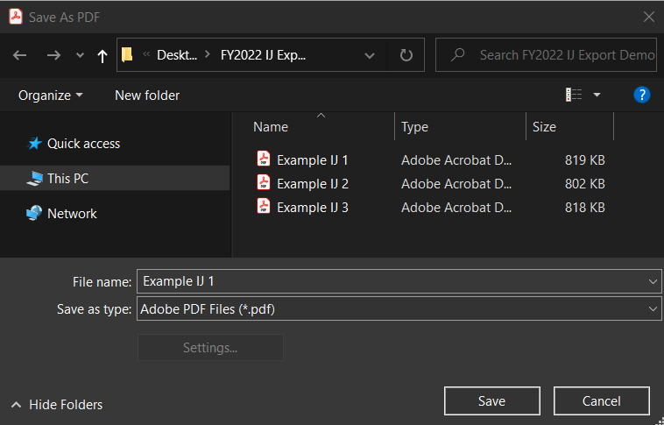
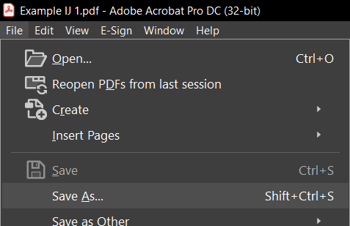
Export Process: Step 1
1. All IJs should be saved as PDFs. Confirm that all IJs are saved as PDFs and use the Save As function if they are not. The export function will only work with PDFs.

Slide 15
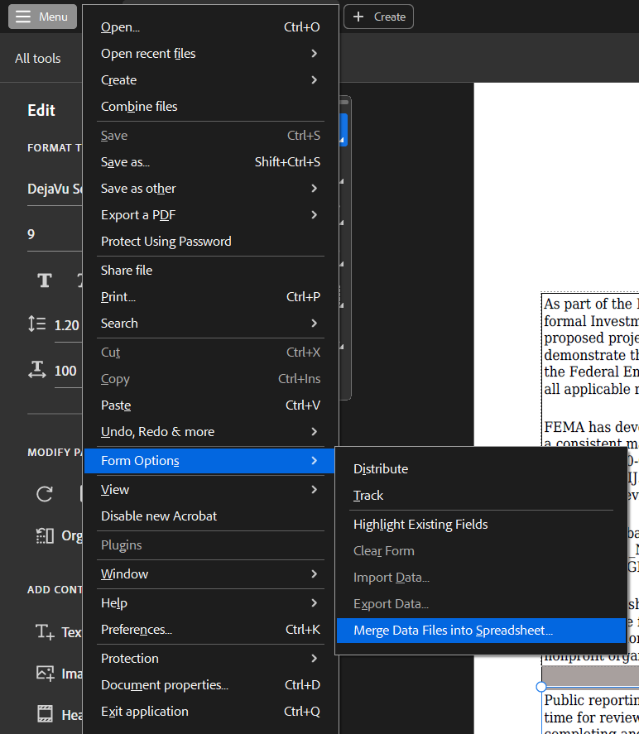
Export Process: Step 2
Please note: Files in this demo use “Example IJ” to designate that this is an example. Please ensure that all of your files use the required NSGP naming conventions as listed in the program documentation (IJ, NOFO).
NSGP-S: FY2026_NSGP_S_<State
Abbreviation>_<Nonprofit Name>
NSGP-UA: FY2026_NSGP_UA_<State Abbreviation>_<Urban Area>_<Nonprofit Name>
2. Once saved, click Edit > Form Options > Merge Data Files into Spreadsheet…

Slide 16
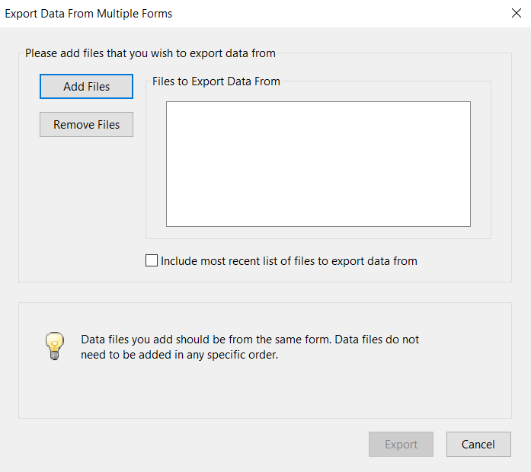
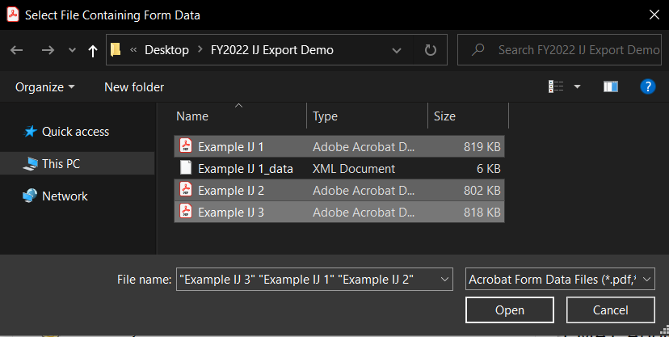
Export Process: Steps 3 & 4
6. Once the dialog box opens, click “Add Files” and select all the PDF ONLY files that need to be included. (This should include all IJs, regardless of whether they will be recommended to FEMA.)
7. Use the “CTRL” function to select multiple files and click “Open” once all necessary files are selected.

Slide 17
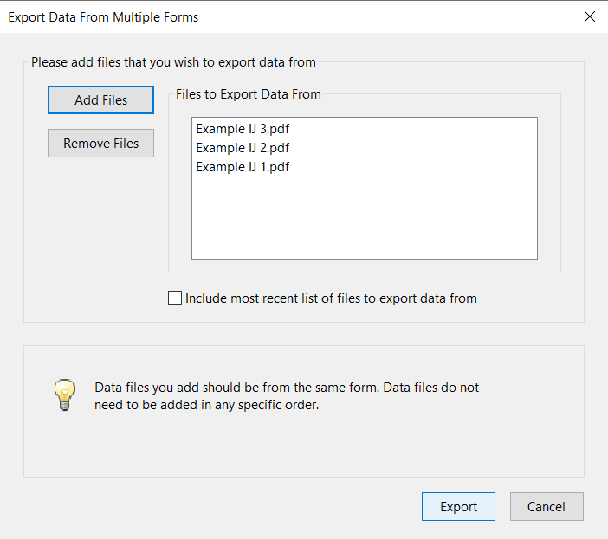
Export Process: Step 5
5. Click “Export”
Reminder: The files listed in this step should only be the PDF IJ files, NOT any other versions!

Slide 18
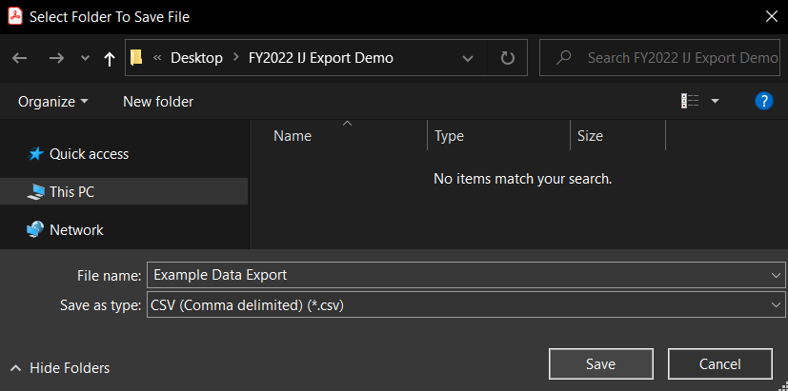
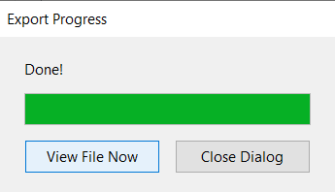
Export Process: Steps 6 & 7
6. When the dialog box opens, enter the file name for the report (all the export data) and click save.
7. Click “View File Now”

Slide 19
Export Result
When you open the Excel file you just saved in the previous step, this is how it will be structured.
The information contained is raw data from the IJ(s) and the headings use coding from the PDF template.
The following slides will help convert this raw data into more usable formatting and headers.

Slide 20
Migration Process

Slide 21
Migration Process
If you want to preserve a copy of the original exported report, save a copy now.
However, you do not have to preserve this file. It can be recreated if needed at any time!
When the report opens, the following columns will align to the information requested in the Prioritization Tracker:
There are multiple methods you can use to transfer this information from the export file into the SAA Prioritization Tracker. Those methods are detailed in the following slides.
B – Organization Name
C, D, E, F (Combined) – Address
N – Nonprofit Organization Category
O – Organization Category, if “Other”
P – Organization Function
Q – Organization Affiliation
R – Affiliation, if “Other”
U – UEI Number
W – Urban Area (if applicable)
X – Total Federal Funding Requested
CR, CS – Prior Funding Received

Slide 22
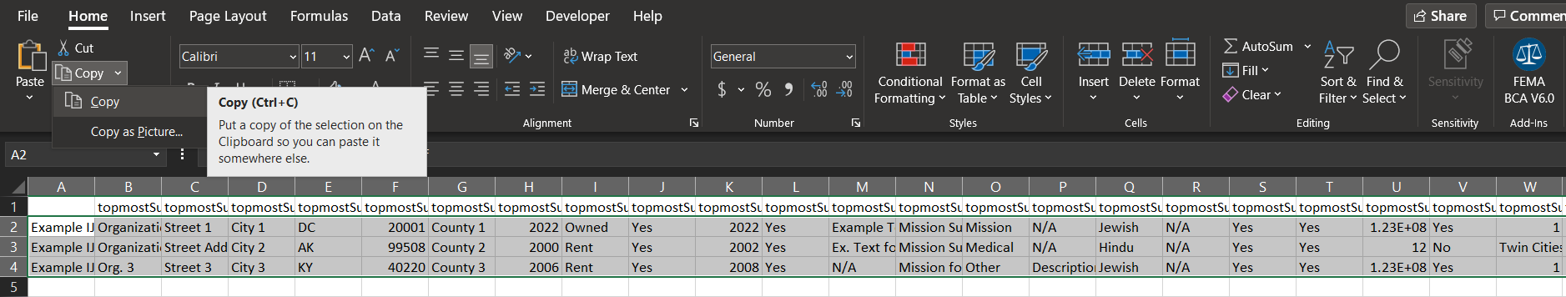
Migration Process
Using the NSGP IJ Export Assistance Data Collection & Cleaning Tool
A. Insert Data
Select ALL data provided by the export file. You can do this by clicking cell A2 and then, before releasing the button on your mouse, drag your cursor to the end of your data (Column CZ, Row __).
  Do not select the column headers.
  Remember that the number of rows of data is based on the number of Investment Justifications included.
Copy the selection.
NOTE: Select the full data range of cells, but do not select the full row. (i.e., do not click “B” to highlight all of row B).

Slide 23
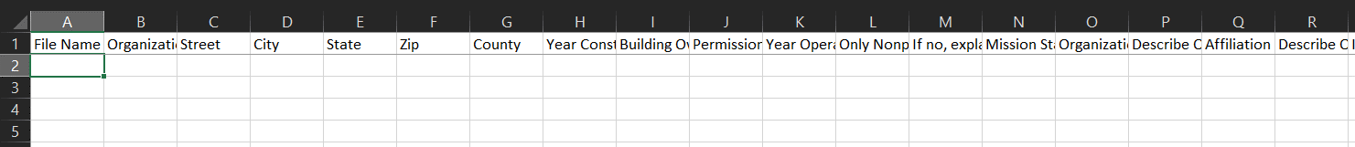
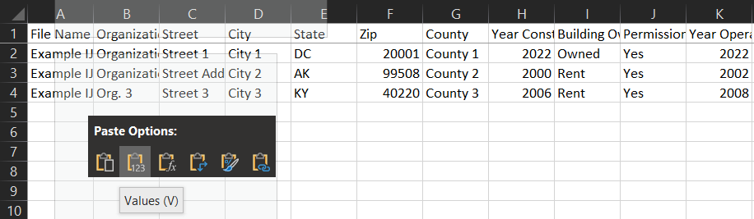
Migration Process
Using the NSGP IJ Export Assistance Data Collection & Cleaning Tool
B. Copy Data
In the Export Assistance file, on the tab labeled “Paste Initial Data Here,” put your cursor in the first blank cell (A2).
Note: The headers in this table will now be more conducive to reviewing/understanding the data.
After you have copied your data and clicked on cell A2, you can right click with your mouse. Select the “Values (V)” option under Paste. Be sure to paste values only!

Slide 24
Migration Process
Using the NSGP IJ Export Assistance Data Collection & Cleaning Tool
C. Review file for use in SAA Prioritization Tracker
In the Export Assistance file, select the tab named “Copy into SAA Prioritization.”
  The display below demonstrates how the data is transformed and ordered to align with the SAA Prioritization tracker. This will allow you to retrieve all information from the IJs and quickly transfer all data into your tracker file for submission to FEMA without having to do any manual data cleaning.
Tip: Based on Excel formatting, sometimes a “0” may show up in cell if you paste data and that cell is empty. Having a zero show up in an otherwise empty cell is not a problem, as long as it is not providing inaccurate data. You should be able to delete or type over these zeroes when/where needed.

Slide 25
Migration Process
Using the NSGP IJ Export Assistance Data Collection & Cleaning Tool
D. Copy information into the SAA Prioritization Tracker
Select the data from the tab labeled “Copy into SAA Prioritization” in the same way you selected data in the prior steps. Remember not to select the column headers!
Select cell C2 in the SAA Prioritization Tracker and Paste values in the same way you did in step 4.
  Note: You will paste into cell C2 of the SAA Prioritization Tracker because cell A2 should list the applying state and cell B2 should list the applying Urban Area (if applicable).
Columns with a yellow header in this spreadsheet indicate the answers you will have to provide manually in the SAA Prioritization Tracker.

Slide 26
Migration Process
NOT USING the NSGP IJ Export Assistance Data Collection
& Cleaning Tool
Copy & Paste without Deleting
Copy & Paste with Deleting
Choosing to retain all of the exported information in the spreadsheet will make the copy and paste transfer process more time-consuming, but it will allow the SAA to have all IJ responses compiled into a single file if that leads to ease of review.
Choosing to delete the extraneous columns will make the copy and paste transfer process quicker, but will then require each IJ to be opened for review.
Federal Emergency Management Agency
26

Slide 27
Migration Process
NOT USING the NSGP IJ Export Assistance Data Collection
& Cleaning Tool
Copy & Paste without Deleting
Copy & Paste with Deleting
Select only the information that corresponds to the requested information in the State Prioritization Tracker.
Copy cells and paste information into the State Prioritization Tracker.
Verify that the information has been migrated correctly, as this will impact the review process.
Delete the columns that do not correspond to requested information in the State Prioritization Tracker.
  The columns that can be deleted (as they exist in the original file) are: A, G, H, I, J, K, L, M, S, U, V, W, Y, Z, AA, AB, AC, AD, AE, AF, AG, AH, AI, AJ, AK, AL, AM, AN, AO, AP, AQ, AR, AS, AT, AU, AV, AW, AX, AY, AZ, BA, BB, BC, BD, BE, BF, BG, BH, BI, BJ, BK, BL, BM, BN, BO, BP, BQ, BR, BS, BT, BU, BV, BW, BX, BY, BZ, CA, CB, CC, CD, CE, CF, CG, CH, CI, CJ, CK, CL, CM, CN, CO, CP, CQ, CT, CU, CV, CW, CX, CY, CZ
Select all remaining information on the spreadsheet.
Copy cells and paste information into the State Prioritization Tracker.
Verify that the information has been migrated correctly, as this will impact the review process
NOTE: Hidden rows/columns will still be copy and pasted if part of the selection.
Federal Emergency Management Agency
27

Slide 28
Export and Migration Recap

Slide 29
Recap
Export
Ensure all IJs are PDFs.
With one IJ open, select Edit > Form Options > Merge Data Files into Spreadsheet
Add Files > Select all PDF IJ files > Open
Export > Save > View File Now
Migration
Open NSGP IJ Export Assistance Data Collection & Cleaning Tool to the tab labeled “Paste Initial Data Here”
Select all data (do not select headers) in the Export File created above and copy
Select cell A2 in NSGP IJ Export Assistance Data Collection & Cleaning Tool and paste values
Use Scoring Tool tab in NSGP IJ Export Assistance Data Collection & Cleaning Tool if desired
Select “Copy into SAA Prioritization Tracker” tab
Select all data (do not select headers) in the “Copy into SAA Prioritization Tracker” tab
Paste values into SAA Prioritization Tracker

Slide 30
If you have questions or need assistance, please email
FEMA-NSGP@fema.dhs.gov

